Slide 2
What is Rhetoric
Rhetoric (n) – the art of speaking or writing effectively
*What does effectively mean to you?

Slide 3
What it means to communicate effectively.

Slide 4
Rhetorical Analysis
Rhetorical Analysis (n) – the act of analyzing the written or spoken word.
Oratorical Analysis (n) – a prepared presentation of a historical or contemporary speech which includes an analysis of the content and the cultural impact of that speech, demonstrating an understanding of the context, the speaker, and the rhetorical elements that made it great.

Slide 5
What does effectively mean to you?

Slide 6
What makes a good speech or argument.

Slide 7
Before You Read
When it comes to rhetorical analysis, there are several things you should do before you even begin reading.
You should analyze…
The speaker
The context

Slide 8
Speaker/Author
The speaker or author is the person who gave the speech or wrote the piece.
It is important to know who the speaker is because it gives you another level of analysis.

Slide 9
Speaker/Author
By knowing the answers to these questions before you read, you will understand more about the piece.
Who is the speaker?
During what time period did the speaker live?
What is the speaker known for?
What does the speaker stand for?

Slide 10
Occasion
The occasion is the general, political, social, or economic state of land during the time when the piece was written or delivered.
It is important to know the context of the piece because the political, social, or economic climate most likely motivated the speaker or author to write the piece.

Slide 11
Occasion
By knowing the answers to these questions before you read, you will understand more about the piece.
When was this written or delivered?
What was happening in history during this time?
Were there any major movements happening during this time?
What was happening shortly before and shortly after this time period?

Slide 12
Audience
You might not be able to identify the entire audience before you read, but it is helpful to start thinking about who the intended audience was before you read.
Knowing who the intended audience is will be helpful in determining the purpose of the speech or piece.

Slide 13
While You Read
Read the text for understanding. You will want to read it all the way through and determine the meaning of unknown words.

Slide 14
While You Read
During your first read, you will want to make sure that you understand the text.
If there is anything in the text that you don’t know, mark it and look it up.
unfamiliar words
period-specific language and references
location-specific language & references

Slide 15
After You Read
After you read the text once or twice, you are not done reading yet. Rhetorical analysis requires multiple close readings for a full understanding.

Slide 16
After You Read
Immediately after you read the text, determine the full audience and purpose.

Slide 17
Audience
Determining the audience involves more than finding who attended the speech or who the piece was written to.
Who was the immediate audience?
Who else received this message?
Who is still receiving this message today?

Slide 18
Purpose
Determining the author’s purpose of a piece is as easy as PIE. Authors will either try to…
Persuade
Inform
Entertain

Slide 19
Purpose
To understand the purpose, you need to know why the author or speaker wrote the text.
What was he or she trying to accomplish?
Why was he or she trying to accomplish this?

Slide 20
Tone
The tone is the author’s attitude toward the subject.
You can determine the author’s attitude by looking at word choice (diction and connotation), sentence structure (syntax), and imagery (figurative language including similes and metaphors).

Slide 21
Tone Words
straightforward | earnest | cynical
optimistic | pessimistic | celebratory
arrogant | gentle | malicious
approving | disapproving | amused
grim | cautious | serious
mocking | detached | indignant
critical | outraged | frustrated
reticent | playful | loving

Slide 22
Using Diction to Determine Tone
Diction is the author or speaker’s choice of words.
Some words have more meaning than others, and effective speakers take time to select the best words to convey their messages.

Slide 23
Connotation vs. Denotation
Denotation is the dictionary definition of a word.
Connotation is the emotional associations attached to a word.
Connotation vs. Denotation Video
EXAMPLE:
building house home
like lust love

Slide 24
Subject
The subject of the text or speech is what it is primarily about.
You should be able to state the subject of the text in just a few words or short phrases.

Slide 25
SOAPStone
Together, these elements form the Acronym SOAPStone.
Speaker
Occasion
Audience
Purpose
Subject
tone
Using SOAPStone to evaluate a text is a smart way to begin your rhetorical analysis.

Slide 26
SOAPStone
Speaker - the person delivering the speech
Occasion - when and where the speech was delivered or the text was written
Audience - who the speaker wanted to reach
Purpose - the reason why the speaker or author wrote the text
Subject - what the text is about
Tone - the author’s attitude toward the subject

Slide 27
Before moving on to rhetorical appeals, let’s use SOAPStone to evaluate a speech.

Slide 28
The Gettysburg Address
Four score and seven years ago our fathers brought forth on this continent, a new nation,
conceived in Liberty, and dedicated to the proposition that all men are created equal.
Now we are engaged in a great civil war, testing whether that nation, or any nation so conceived and dedicated, can long endure. We are met on a great battle-field of that war. We have come to dedicate a portion of that field, as a final resting place for those who here gave their lives that that nation might live. It is altogether fitting and proper that we should do this.
But, in a larger sense, we can not dedicate -- we can not consecrate -- we can not hallow -- this ground. The brave men, living and dead, who struggled here, have consecrated it, far above our poor power to add or detract. The world will little note, nor long remember what we say here, but it can never forget what they did here. It is for us the living, rather, to be dedicated here to the unfinished work which they who fought here have thus far so nobly advanced. It is rather for us to be here dedicated to the great task remaining before us -- that from these honored dead we take increased devotion to that cause for which they gave the last full measure of devotion -- that we here highly resolve that these dead shall not have died in vain -- that this nation, under God, shall have a new birth of freedom -- and that government of the people, by the people, for the people, shall not perish from the earth.

Slide 29
SOAPStone
Speaker
Occasion
Audience
Purpose
Subject
Tone
President Abraham Lincoln. The 16th US President. President during the Civil War.

Slide 30
SOAPStone
Speaker
Occasion
Audience
Purpose
Subject
Tone
Civil War. The dedication of a cemetery near the site of the Battle of Gettysburg. November 19, 1863.

Slide 31
SOAPStone
Speaker
Occasion
Audience
Purpose
Subject
Tone
people attending the speech, military personnel and their families, supporters of the Union, critics of the war, Confederates, future generations

Slide 32
SOAPStone
Speaker
Occasion
Audience
Purpose
Subject
Tone
Lincoln wanted to unify the nation and ensure that the nation would continue to live.

Slide 33
SOAPStone
Speaker
Occasion
Audience
Purpose
Subject
Tone
Fighting and conflict during the Civil War

Slide 34
SOAPStone
Speaker
Occasion
Audience
Purpose
Subject
Tone
reverent, solemn, hopeful, unifying

Slide 35
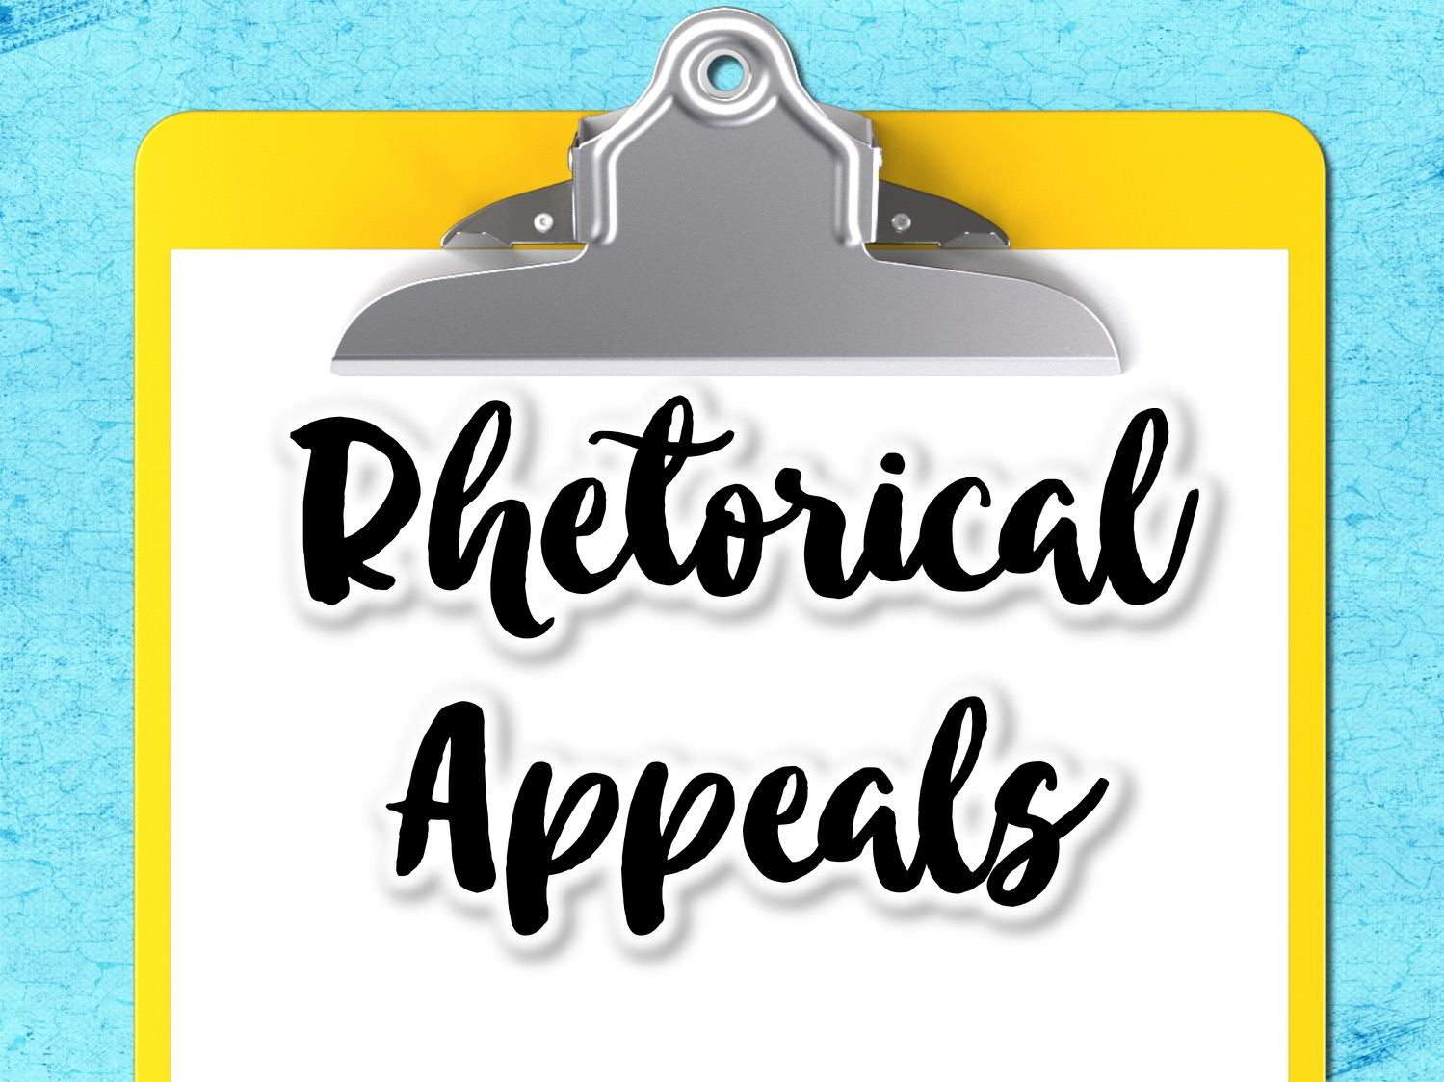

Slide 36
Rhetorical Triangle
The rhetorical triangle is made up of three persuasive strategies.
ETHOS
LOGOS
PATHOS

Slide 37
Rhetorical Triangle
According to Aristotle, ethos, pathos, and logos are the three main modes of persuasion.
Analyzing an argument for its use of ethos, pathos, and logos is one way to conduct rhetorical analysis.

Slide 38
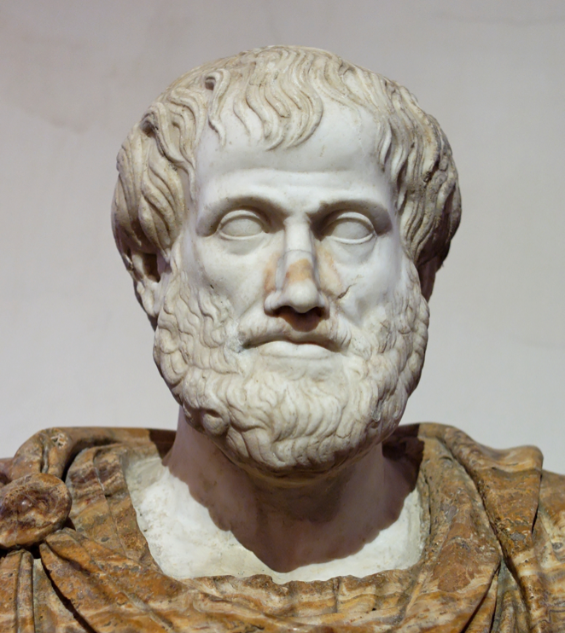
Aristotle
(384 BCE – 322 BCE)
Greek philosopher and scientist
One of the great ancient philosophers
Tutored Alexander the Great
Wrote “On Rhetoric” in 350 B.C.E
Considered the father of rhetoric

Slide 39
Ethos, Pathos, Logos
Appeal to Ethics and Credibility
Based on the speaker or author
Is the author reliable and credible?
Is the author knowledgeable?
Appeal to Emotions
Based on how the text makes the reader/audience feel
How does the text make the audience feel?
Appeal to Logic and Reason
Based on facts, research, and evidence
How do the facts and evidence support the claim?
ETHOS
PATHOS
LOGOS

Slide 40
Ethos
Ethos is an effective argumentative and persuasive strategy because when the audience believes that the author is knowledgeable and genuine, the audience is more willing to listen and be persuaded.

Slide 41
Ethos
Ask these questions to determine Ethos
Does the writer/speaker seem trustworthy?
Does the writer/speaker seem knowledgeable?
How does the writer/speaker establish credibility and authority?

Slide 42
Ethos Examples
Dr. Martin Luther King Jr.’s “Letter from the Birmingham Jail” is effective because he establish credibility as an African-American male who was in jail. It was authentic and real.
When a trusted doctor gives you medical advice, you follow it, even if you do not understand the medical reasoning behind it. This is because you trust the doctor.

Slide 43
Logos
Logos is an effective argumentative and persuasive strategy because when the audience is presented with factual, researched evidence supporting the claims, the audience is more likely to consider the claims valid.
Logos is much more important in argumentative writing than it is in persuasive writing.

Slide 44
Logos
Ask these questions to determine Logos
What claim is the author/speaker arguing?
Is the author/speaker’s evidence relevant?
Does the author/speaker include logical fallacies in his/her argument?
What evidence does the author/speaker use to support his/her claim?

Slide 45
Logos Examples
Any argument that includes logical and relevant evidence (researched data, facts, statistics, events, etc.) includes Logos.

Slide 46
Pathos
Pathos is an effective persuasive* strategy because the audience may accept claims based on how the text makes them feel, rather than factual data.
Pathos is much more important in persuasive writing than it is in argumentative writing.
*Pathos should be used sparingly in argumentative writing

Slide 47
Pathos
Ask these questions to determine Pathos
Does the author/speaker appeal to your emotions?
What feelings do you feel when reading the text?
How did the writer establish or create a relationship with you?

Slide 48
Pathos Example
Lee Greenwood’s song Born in the USA became very popular after the September 11 attacks
Empathizing with a friend who is experiencing a break up.

Slide 49
Persuasive Techniques in Relation to Ethos, Pathos, and Logos
Ethos
A well-researched and thoroughly developed argument
Trustworthiness
Credibility
Pathos
Arguments built on the way that will evoke certain emotions in the audience
Connotation
Loaded words
Repetition
Logos
A sensible and logical argument built on relevant and sufficient evidence.
Facts and statistics
Claims based on general logic

Slide 50
Before moving on to rhetorical devices, let’s analyze the Gettysburg Address for ethos, pathos, and logos.

Slide 51
The Gettysburg Address
Four score and seven years ago our fathers brought forth on this continent, a new nation,
conceived in Liberty, and dedicated to the proposition that all men are created equal.
Now we are engaged in a great civil war, testing whether that nation, or any nation so conceived and dedicated, can long endure. We are met on a great battle-field of that war. We have come to dedicate a portion of that field, as a final resting place for those who here gave their lives that that nation might live. It is altogether fitting and proper that we should do this.
But, in a larger sense, we can not dedicate -- we can not consecrate -- we can not hallow -- this ground. The brave men, living and dead, who struggled here, have consecrated it, far above our poor power to add or detract. The world will little note, nor long remember what we say here, but it can never forget what they did here. It is for us the living, rather, to be dedicated here to the unfinished work which they who fought here have thus far so nobly advanced. It is rather for us to be here dedicated to the great task remaining before us -- that from these honored dead we take increased devotion to that cause for which they gave the last full measure of devotion -- that we here highly resolve that these dead shall not have died in vain -- that this nation, under God, shall have a new birth of freedom -- and that government of the people, by the people, for the people, shall not perish from the earth.

Slide 52
Work in partners or small groups to analyze the text for Lincoln’s use of ethos, pathos, and logos.

Slide 53
Ethos
“It is rather for us to be here dedicated to the great task remaining before us -- that from these honored dead we take increased devotion to that cause for which they gave the last full measure of devotion…”
Lincoln establishes ethos in this passage because it shows his compassion. It shows that he wants what is best for the nation and to those who gave everything.

Slide 54
Pathos
“that we here highly resolve that these dead shall not have died in vain…”
Lincoln establishes pathos in this passage because he evokes emotion (sympathy and sadness) for the people who were lost fighting in the war.

Slide 55
Logos
“Four score and seven years ago our fathers brought forth on this continent, a new nation, conceived in Liberty, and dedicated to the proposition that all men are created equal.”
Lincoln establishes logos in this passage because he is including logic and factual information to help him prove his point.

Slide 57
Rhetorical Devices
Tropes
Schemes
A trope is an artful variation from the typical or expected way a word or idea is expressed; it is the figurative use of a word. Tropes focus on the significance of word choice (diction).
A scheme is an artful variation from the typical arrangement of words in a sentence. Schemes focus on the arrangement of words. Schemes are related to sentence structure (syntax).

Slide 58
Tropes
Tropes Involving Comparison
Tropes Involving Word Play and Sounds
Tropes Involving Overstatement or Understatement
Remember: Tropes focus on the significance of word choice (diction).

Slide 59
Tropes Involving Comparison
These tropes have the effect of using imagery to create and enhance meaning.
Allusion
Apostrophe
Metaphor
Simile
Personification

Slide 60
Allusion
A brief reference to a real or fictitious person, place, event, or work of art.
Example: A reference to Eden, Scrooge, or Picasso in a work is an allusion.

Slide 61
Apostrophe
Addressing a person in a speech or composition who is not present.
Example: “Oh Romeo, Romeo! Wherefore art thou Romeo?”
Romeo and Juliet. Act II Scene 2 Line 33

Slide 62
Metaphor
An expression of meaning that compares two unlike things.
Example: “But there are many mountaintops yet to climb. We will not rest until every American enjoys the fullness of freedom, dignity, and opportunity as our birthright.”
President Ronald Reagan, Inaugural Address - January 21, 1985

Slide 63
Simile
A comparison of two unlike things using the words “like” or “as.”
Example: The young girl is as brave as a lion.

Slide 64
Personification
Giving inanimate objects human characteristics.
Example: The lightning danced across the night sky.

Slide 65
Tropes Involving Word Play & Sounds
These tropes have the effect of using sounds to create and enhance meaning.
Alliteration
Assonance
Consonance
Onomatopoeia

Slide 66
Alliteration
The repetition of the same letter at the beginning of adjacent or closely placed words.
Example: “They are part of the finest fighting force that the world has ever known.”
President Barack Obama, Fort Hood Memorial Service Speech - November 10, 2009.

Slide 67
Assonance
The repetition of vowel sounds between different consonants inside a line.
Example: “Fire at the private eye hired to pry in my business”
Eminem

Slide 68
Consonance
The repetition of the same consonant sounds repeated in a group of words.
Example: The early bird gets the worm.

Slide 69
Onomatopoeia
The intentional use of words that sound like their meaning.
Examples: Buzz, Zap, Pow

Slide 70
Tropes Involving Statement
Tropes involving overstatement or understatement have the effect of using exaggerations to create or enhance meaning.
Hyperbole
Oxymoron
Rhetorical Question

Slide 71
Hyperbole
A gross exaggeration to make an effect or to highlight something.
Example: “So first of all, let me assert my firm belief that the only thing we have to fear is fear itself.”
President Franklin Delano Roosevelt, First Inaugural Address - March 4, 1933

Slide 72
Oxymoron
The intentional use of an apparent contradiction.
Examples: Great Depression, jumbo shrimp, only choice

Slide 73
Rhetorical Question
The purposeful inclusion of a question intended not to be answered, but to evoke deep thought.
Example: Why should we even learn to read anyways?

Slide 74
Tropes
Comparison | Word Play | Over or Understatement
Allusion Apostrophe Metaphor Simile Personification | Alliteration Assonance Consonance Onomatopoeia | Hyperbole Oxymoron Rhetorical Question

Slide 75
Schemes
Schemes Involving Balance
Schemes Involving Omission
Schemes Involving Repetition
Remember: Schemes are a purposeful variation from the typical arrangement of words within a sentence (syntax).

Slide 76
Schemes Involving Balance
Schemes involving balance are when writers use balance in writing to illustrate or highlight the importance of ideas.
Parallel Structure
Juxtaposition

Slide 77
Parallel Structure
A similarity of structure in a pair or series of related words, phrases, or clauses.
Example: “This nation, under God, shall have a new birth of freedom; and that government of the people, by the people, for the people, shall not perish from earth.”
President Abraham Lincoln, The Gettysburg Address - November 19, 1863

Slide 78
Juxtaposition
The placing of two things closely together to emphasize the comparisons or contrasts.
Example: dark and light, life and death, beauty and ugliness, poverty and wealth

Slide 79
Schemes Involving Omission
Schemes involving omission are when writers purposefully leave things out in order to highlight an idea.
Asyndeton
Polysyndeton

Slide 80
Asyndeton
The purposeful omission of words by which the meaning is still clear because of the context.
Example: “I came, I saw, I conquered?”
Julius Caesar, after the battle of Zela - 47 BC

Slide 81
Polysyndeton
A literary technique that uses conjunctions in repeated succession -oftentimes with no commas.
Example: “It’s got awesome security. And the right apps. It’s got everything from Cocoa and the graphics and it’s got core animation built in and it’s got the audio and video that OSX is famous for. It’s got all the stuff we want.”
Steve Jobs, MacWorld Keynote - 2007

Slide 82
Schemes Involving Repetition
Schemes involving repetition occur when writers use repetition for emphasis to make a text memorable, forceful, and artistic.
Anadiplosis
Anaphora
Chiasmus

Slide 83
Anadiplosis
The repetition of the last word of one clause at the beginning of the next.
Example: "They call for you: The general who became a slave; the slave who became a gladiator; the gladiator who defied an Emperor. Striking story. Now the people want to know how the story ends."
From the movie “Gladiator”

Slide 84
Anaphora
The repetition of a phrase for emphasis.
Example: “We shall fight in France, we shall fight on the seas and oceans, we shall fight with growing confidence and growing strength in the air, we shall defend our island, whatever the cost may be. We shall fight on the beaches, we shall fight on the landing grounds, we shall fight in the fields and in the streets, we shall fight in the hills …”
Winston Churchill, House of Commons - June 4, 1940

Slide 85
Chiasmus
This occurs when the first clause or phrase is reversed in the second. Sometimes it will repeat the same words.
Example: “And so, my fellow Americans, ask now what your country can do for you; ask what you can do for your country.”
President John F. Kennedy, First Inaugural Address - January 20, 1961

Slide 86
Schemes
Balance | Omission | Repetition
Parallel Structure Juxtaposition | Asyndeton Polysyndeton | Anadiplosis Anaphora Chiasmus

Slide 87
Top 10 Famous Speeches
Martin Luther King, Jr. - I Have A Dream
John Fitzgerald Kennedy - Inaugural Address
Franklin Delano Roosevelt - First Inaugural Address
Franklin Delano Roosevelt - Pearl Harbor Address to the Nation
Barbara Charline Jordan - 1976 DNC Keynote Address
Richard Milhous Nixon - Checkers
Malcom X - The Ballot or the Bullet
Ronald Wilson Reagan - Shuttle 'Challenger' Disaster Address
John Fitzgerald Kennedy - Houston Ministerial Association
Lyndon Baines Johnson - We Shall Overcome
https://www.americanrhetoric.com/top100speechesall.html

